Slide 1
How to Solve the EV Challenge
EVs are Win-Win-Win
  Good for your customers/members
  Good for the environment
  Good for your bottom line (if you are careful)
Charging
  Timing and Level of Charging is Crucial

Slide 2
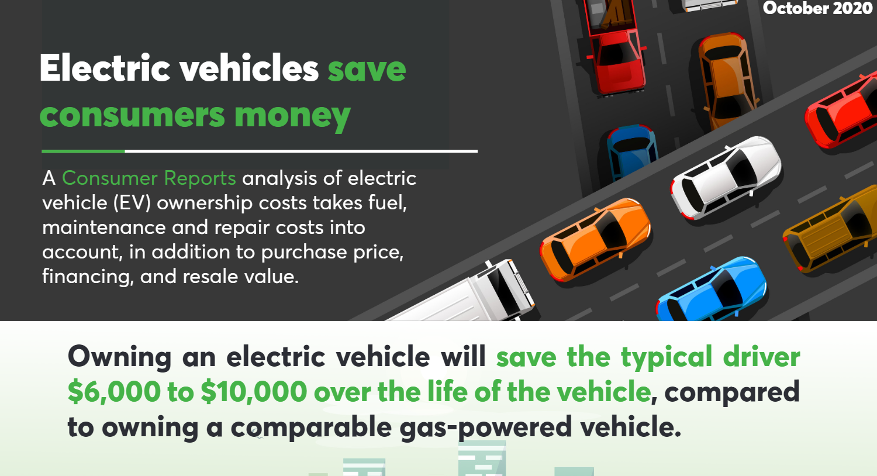
Electric vehicles save consumers money
Notes:
https://www.consumerreports.org/hybrids-evs/evs-offer-big-savings-over-traditional-gas-powered-cars/

Slide 3
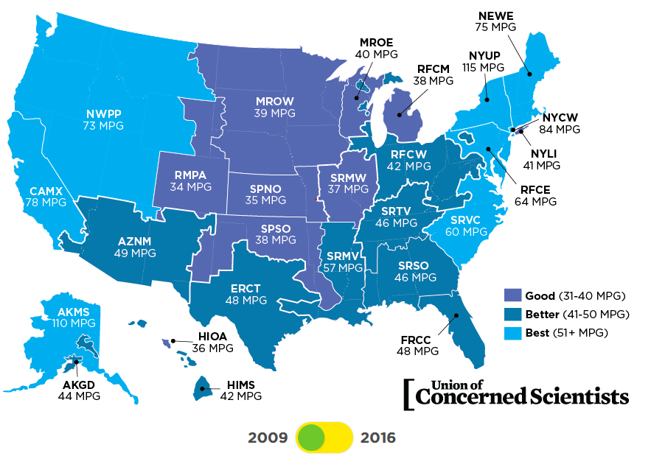
Union of Concerned Scientists US Map

Slide 4
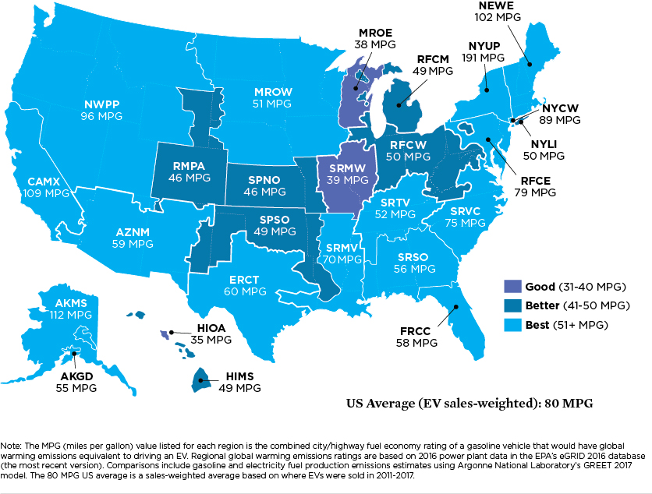
Cleaner over Time
As electricity becomes cleaner, so does your car. Here’s the same map from 2016

Slide 5
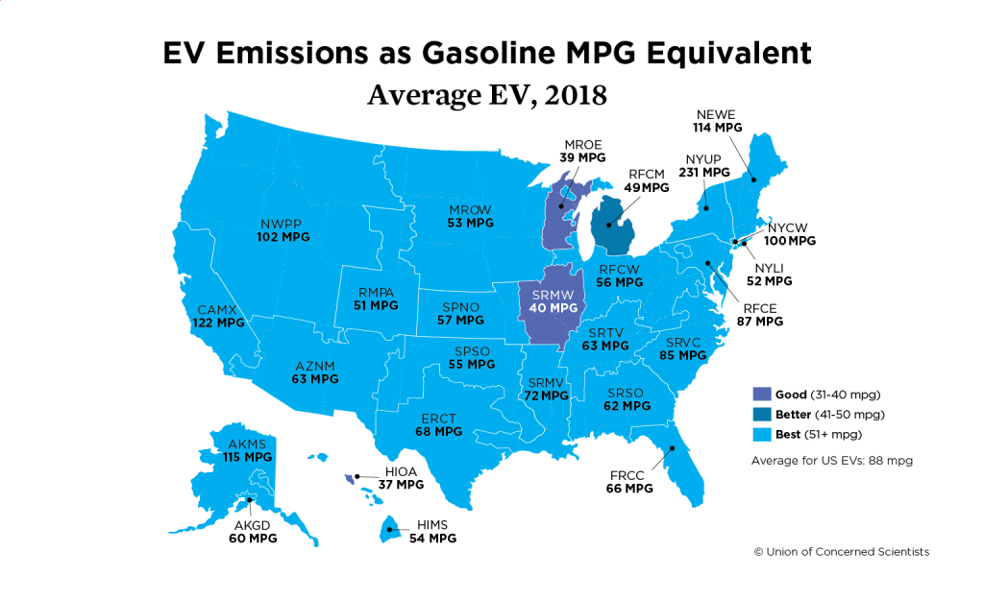
EV Emissions as Gasonline MPG Equivalent

Slide 6
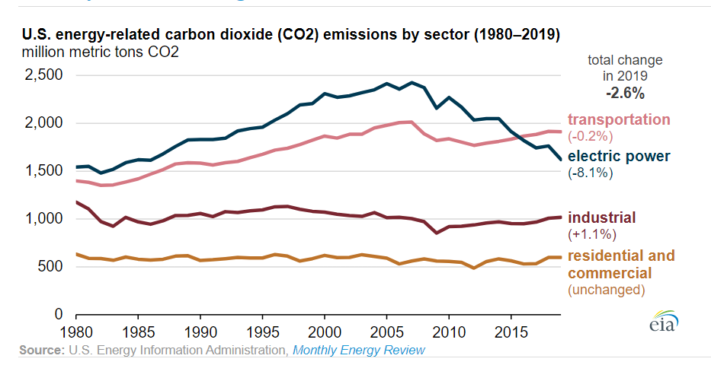
Transportation: US’s Largest Greenhouse Gas Sector, since 2016
Notes:
Crossover point was February 2016, both electricity and transportation account for about 1/3 of US carbon emissions.
FYI, over half of transportation emissions come from gasoline
https://www.eia.gov/todayinenergy/detail.php?id=45836#

Slide 7
A Win* for the Utility
          *pending
The timing and level of EV charging is very important
High amounts of EV charging at system peak is problematic
Good News: Most charging is and will be done at home
  It’s easy to make sure this happens at night (send a market signal)
  Level 2 Chargers can provide 50+ miles of charging overnight

