Slide 1
Renewable Dreams, Hydrocarbon Realities, And The Real Fuels Of The Future
Robert Bryce presentation to:
Energy Trends Workshop
Des Moines, IA
May 4, 2023

Slide 2
“We’re going through an incredible transition that is taking place that, God willing, when it’s over, we’ll be stronger and the world will be stronger and less reliant on fossil fuels when this is over.”
● President Joe Biden, May 23, 2022
Source: https://www.foxnews.com/politics/president-biden-incredible-transition-high-gas-prices
©Robert Bryce
Notes:
A recent Princeton study put figure at 600,000 sq kms. See: https://netzeroamerica.princeton.edu/img/Princeton_NZA_Interim_Report_15_Dec_2020_FINAL.pdf, 106

Slide 3
“The energy transition is well underway.”
● Politico, March 3, 2023
Source: https://www.politico.com/newsletters/power-switch/2023/03/03/the-puzzle-facing-bidens-energy-transition-00082767
©Robert Bryce

Slide 4
“The Administration is continuing to implement the Inflation Reduction Act, which is already galvanizing our clean energy transition and making clean and energy efficient technologies more affordable for American families.”
● White House Press release, March 9, 2023
Source: https://www.whitehouse.gov/briefing-room/statements-releases/2023/03/09/fact-sheet-president-bidens-budget-lowers-energy-costs-combats-the-climate-crisis-and-advances-environmental-justice/
©Robert Bryce

Slide 5
Occurrences of “energy transition” In New York Times, 2015 to 2022
Source: New York Times
© Robert Bryce

Slide 6
Occurrences of “energy transition” In NewsBank, 2015 to 2022
Source: NewsBank
© Robert Bryce

Slide 7
What Energy Transition? Energy Poverty Is Rampant and Deadly
Source: AP
© Robert Bryce

Slide 8
In 2021, >260 Human Beings Were Burned Alive Due to Extreme Energy Poverty
Source: AP
© Robert Bryce
Notes:
Lebanon, Kenya, Haiti, Sierra Leone

Slide 9
Shares Of Global Primary Energy, 1985 & 2021 After ≈$3.7T Spent On Wind & Solar
88%
83%
5%
27 EJ
266 EJ
490 EJ
224 EJ increase in HC
Source: BP, https://about.bnef.com/blog/global-low-carbon-energy-technology-investment-surges-past-1-trillion-for-the-first-time/ .
https://taiyangnews.info/business/bloombergnef-260-gw-new-solar-installed-in-2022-globally/
© Robert Bryce
Notes:
Between 2011 and 2018 global spending on solar and wind energy totaled some $2 trillion.
Over 35 years, hydrocarbons share of global primary energy declined by 5%.

Slide 10
What Energy Transition? In 2021, Global HC Use Grew 4.9x Faster Than Wind & Solar; Oil Grew 2x Faster
5.5
26.9
Increase, EJ per year
Sources:BP
© Robert Bryce
Notes:
The increase in oil use was greater than the output of ALL global solar.

Slide 11
“CO₂ Emissions In 2022” Report By International Energy Agency, March 2:
.
● “Global energy-related CO₂ emissions grew by 0.9% or 321 Mt...reaching a new high of over 36.8 Gt”
● “CO₂ emissions from coal grew by 1.6% or 243 Mt...reaching a new all-time high of almost 15.5 Gt.”
● “Emissions from oil grew even more than emissions from coal, rising by 2.5% or 268 Mt to 11.2 Gt.”
● The biggest sectoral increase “came from electricity and heat generation, whose emissions were up by 1.8% or 261 Mt.”
Sources: https://iea.blob.core.windows.net/assets/3c8fa115-35c4-4474-b237-1b00424c8844/CO2Emissionsin2022.pdf
© Robert Bryce
Notes:
The hydrocarbon sector is irreplaceable.

Slide 12
Shares of US Primary Energy, 1985 & 2021 After ≈$900B Spent on Wind & Solar
6%
65 EJ
76 EJ
9 EJ increase in HC
Sources:BP, BNEF
© Robert Bryce
Notes:
Over 35 years, hydrocarbons share of US primary energy declined by 8%.

Slide 13
In 2021, US Hydrocarbon Use Grew 5.7x Faster than Wind & Solar
Wind + Solar
Gas + Oil + Coal
2.8
4
Change, EJ per year
Sources:BP
© Robert Bryce
Notes:
The hydrocarbon sector is irreplaceable.

Slide 14
In 2022, US Hydrocarbon Use Grew 55% Faster Than Wind & Solar Combined
Wind + Solar
0.9
Coal + Oil + Gas
-0.8
0.7
1.4
Change, EJ per year
Sources:BP, EIA,
© Robert Bryce
Notes:
The hydrocarbon sector is irreplaceable.

Slide 15
Biden’s Zero-Carbon Grid Needs 2,700 TWh/yr Of New Zero-C Juice by 2035. From Where Will It Come?
2021 Electricity Generation, Terawatt-hours
Source: BP.
© Robert Bryce
Notes:
NOT A WORD ABOUT NUCLEAR IN BIDEN’S STATE OF THE UNION.
US coal+gas = 16x US solar
= 7x US wind
= 1.5x global wind

Slide 16
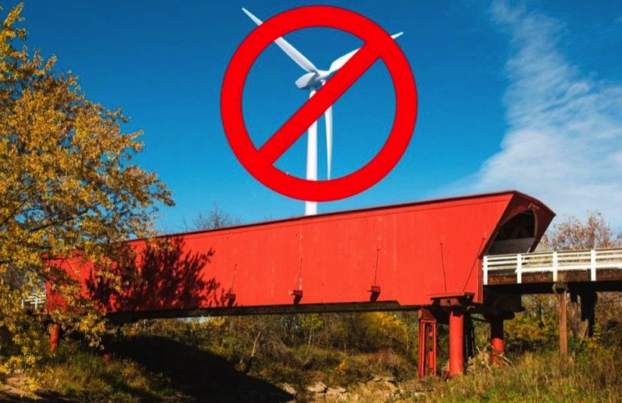
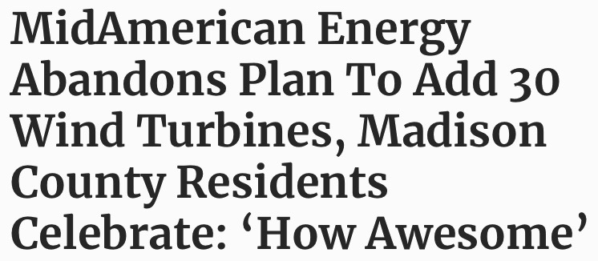
Big Wind: Friction From Norway to Nebraska
Source: Media outlets
© Robert Bryce

Slide 17
US Wind Energy Rejections, 2015 to 2023
At least 375 rejections or restrictions since 2015
Source: Renewable Rejection Database
© Robert Bryce
Notes:
Gage County, Nebraska.
Wheeler County, Nebraska
Madison County, IA

Slide 18
US Solar Energy Rejections, 2017 to 2023
At least 120 rejections or restrictions of solar energy since 2017
Source: Renewable Rejection Database
© Robert Bryce
Notes:
More than 40 of these in 2022 have happened in Ohio.

Slide 19
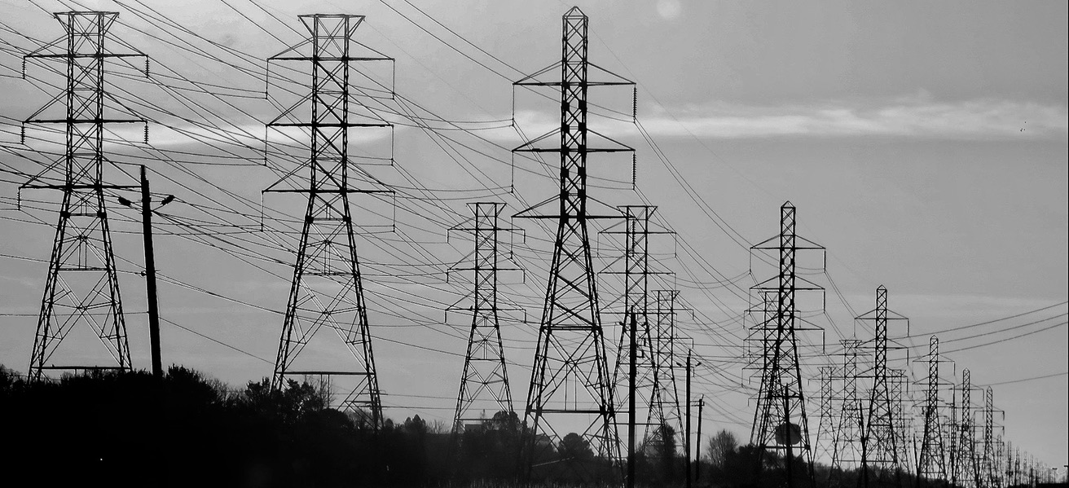
All-Renewable Schemes Require Massive Increases in High-Voltage Transmission
● NREL: 90% renewable electricity requires doubling HV transmission
● US has 240,000 miles of HV transmission (230kV and up)
● From 2008 to 2021, US built 1,700 miles/year of HV transmission
Sources: NREL, C Three Group
© Robert Bryce

Slide 20
No Transition Without Transmission: Years Needed For Grid Buildout At Current Growth Rate
“...we need to expand electricity transmission systems by 60% by 2030, and may need to triple it by 2050 to meet the country’s increase in renewable generation and expanding electrification needs.”
-- Department of Energy, May 10, 2022
Years needed
Sources: C Three Group, DOE, https://www.energy.gov/articles/biden-administration-launches-25-billion-fund-modernize-and-expand-capacity-americas-power
© Robert Bryce

Slide 21
Out Of Transmission: HV Projects Face Fierce Opposition
.
● In 2017, Iowa enacted law prohibiting the use of eminent domain for HV transmission lines, killing Rock Island Clean Line
● In 2018, NH regulators rejected Northern Pass Transmission
● Grain Belt Express still waiting for permits to cross MO
● Trans West Express in WY, proposed in 2005, still not built
● New England Clean Energy Connect, proposed in 2017, won recent round in court, project still in legal limbo
Sources: media outlets, https://energynews.us/2023/04/17/the-fate-of-a-key-transmission-line-in-maine-is-on-trial-now/
© Robert Bryce
Notes:
The hydrocarbon sector is irreplaceable.

Slide 22
What About The Kit? Transformer Shortages; Utility Product Cost Inflation “At an all-time high”
● “In just two years, all-product costs have increased by one third.”
● Transformer industry has 1- to 2-year lead times
● US has one domestic maker of grain-oriented electrical steel
^{-- RESCO, February 2023}
RESCO’s Utility Product Inflation Rates, 2015-2022
Source: Matt Brandrup, Rural Electric Supply Cooperative
© Robert Bryce

Slide 23
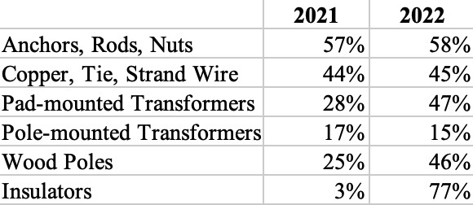
Cost Increases For Specific Utility Products In 2021 and 2022
Source: Buddy Hasten, Arkansas Electric Cooperative Corporation
© Robert Bryce

Slide 24
The Iron Law Of Electricity:
People, businesses, and countries will do whatever they have to do to get the electricity they need.
People waiting to buy gasoline for their generators,
Staten Island, NY, November, 2012
© Robert Bryce

Slide 25
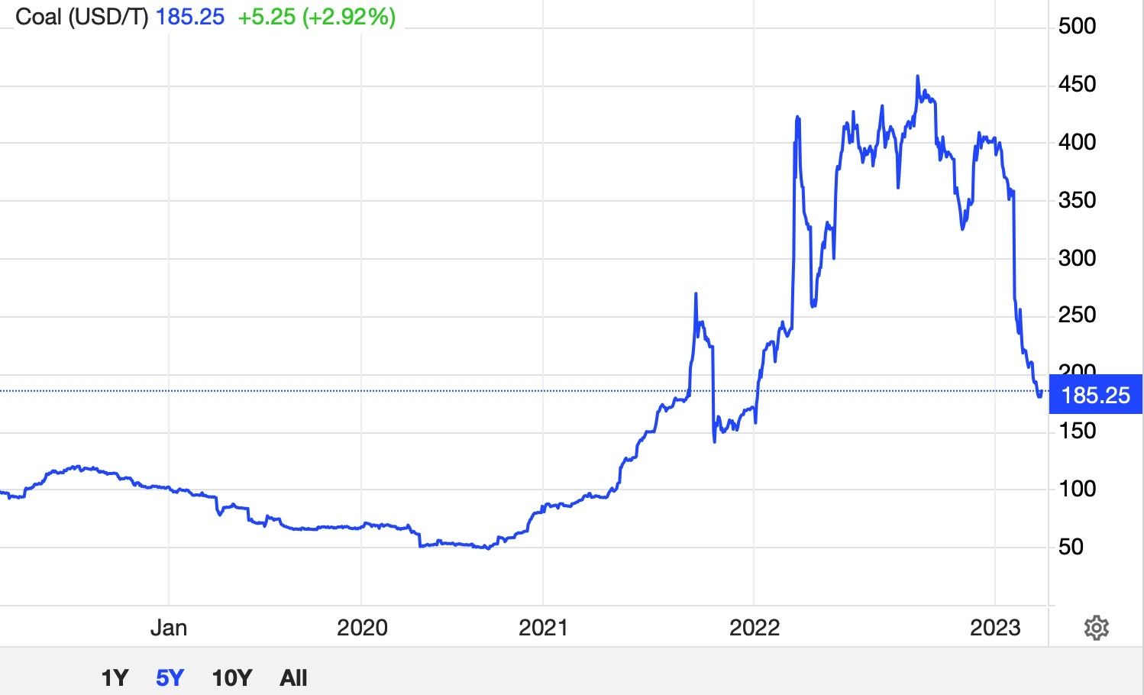
King Coal Comes Storming Back
“China began construction on 15 gigawatts of new coal-fired power...The volume of new projects...amounts to almost one coal plant unit per week.”
-- Global Energy Monitor, August 2022
Source: Media outlets, https://tradingeconomics.com/commodity/coal https://time.com/6090732/china-coal-power-plants-emissions/
© Robert Bryce

Slide 26
● “The electric automobile will quickly and easily take precedence over all other kinds of motor carriages as soon as an effective battery of light weight is discovered.” -- Los Angeles Times, 1901 ● “Prices on electric cars will continue to drop until they are within reach of the average family.” -- Washington Post, 1915
EVs Are The Next Big Thing...
Source: NY Times, Library of Congress, https://www.eia.gov/todayinenergy/detail.php?id=51218
© Robert Bryce

Slide 27
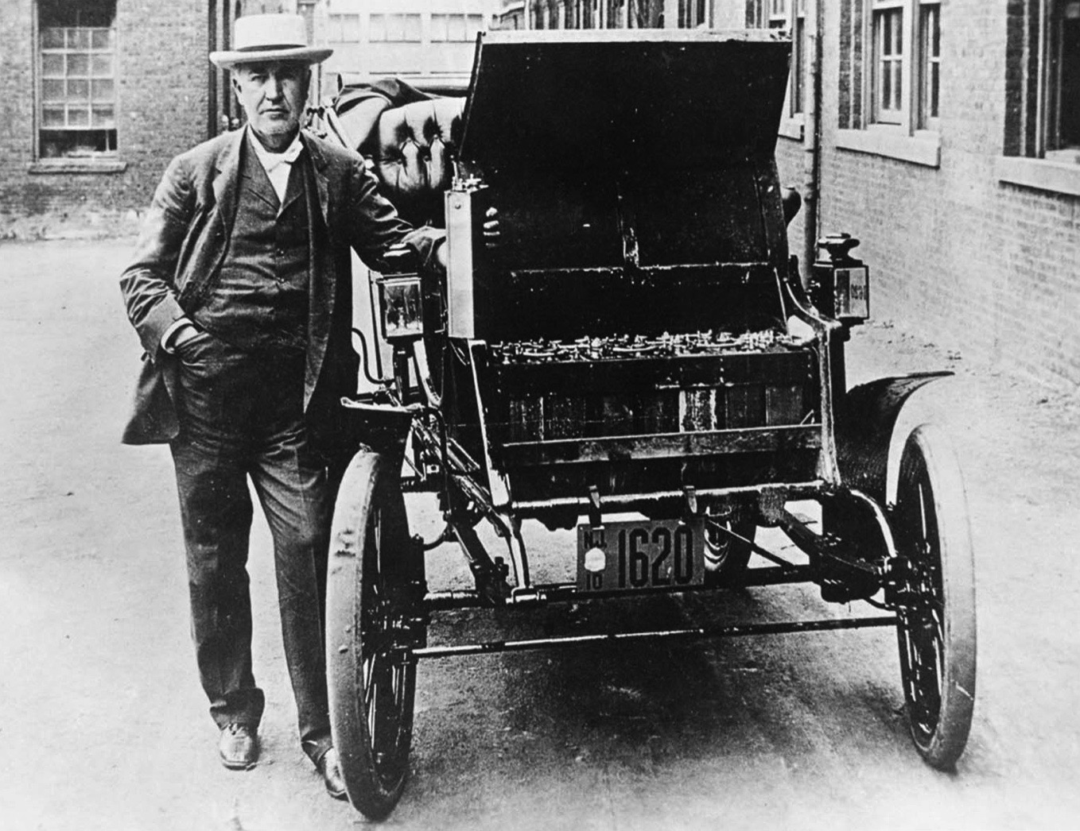
Is It Different This Time?
● EV sales grew by 65% in 2022 ● EVs totaled 5.7% of US new car sales in 2022
Source: https://cleantechnica.com/2023/02/25/us-electric-car-sales-increased-65-in-2022/
© Robert Bryce

Slide 28
What About Affordability?
● Average household income for EV buyers is about $140,000 per year. That’s 2x US average
● Average price for a new EV last year was about $66,000 “well above the industry average and more aligned with luxury prices than mainstream prices.”
● “Price is the number one barrier to EV adoption...We should be getting more affordable EVs, we're promised that by the automakers, but they're not here right now.”
-- Michelle Krebs, Cox Automotive
Source: https://www.axios.com/2022/08/01/electric-vehicle-adoption-barriers
© Robert Bryce

Slide 29
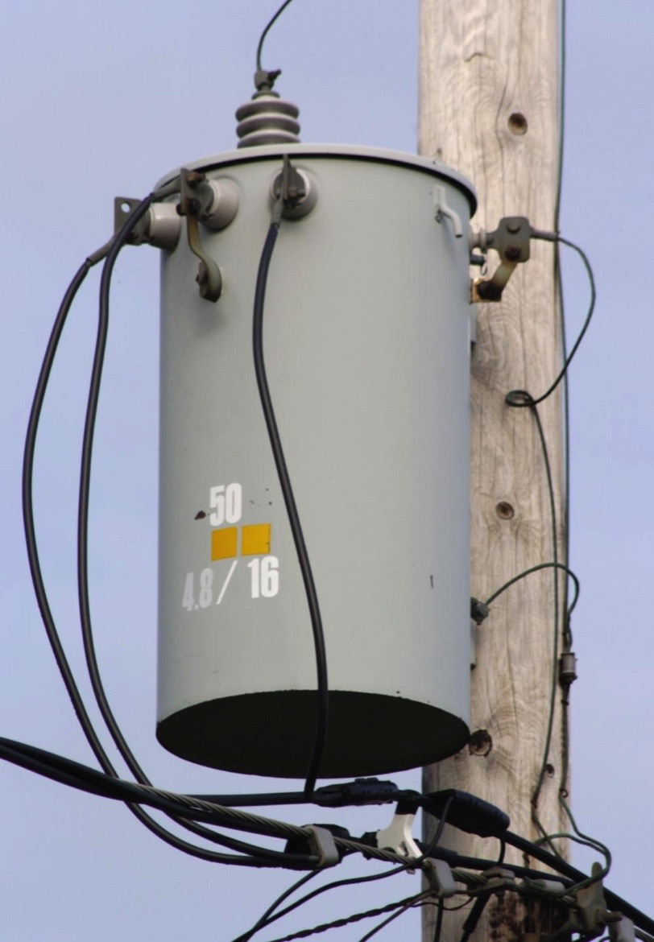
EVs Will Increase Electricity Demand. Who Will Pay For Grid Upgrades?
● EPRI: One Amazon depot with 200 EV trucks = 5 MW of new load
● Boston Consulting Group: A model utility with 2 to 3 million customers will need to invest between $1,700 and $5,800 in grid upgrades per EV through 2030
Source: EPRI, Reuters
© Robert Bryce

Slide 30
Just Stop Oil? If Oil Didn’t Exist, We’d Have To Invent It Energy Density Of Gasoline Is 40x That Of Li-ion
Watt-hours per kilogram
Sources: Donald Sadoway, MIT;; David J.C. MacKay, “Without the Hot Air,” https://insideevs.com/news/598656/tesla-4680-battery-cell-specs/
© Robert Bryce

Slide 31
Gasoline Prices Have Been Flat Since 1976
US dollars per gallon, in real terms
Source: EIA, https://www.eia.gov/outlooks/steo/realprices/
© Robert Bryce

Slide 32
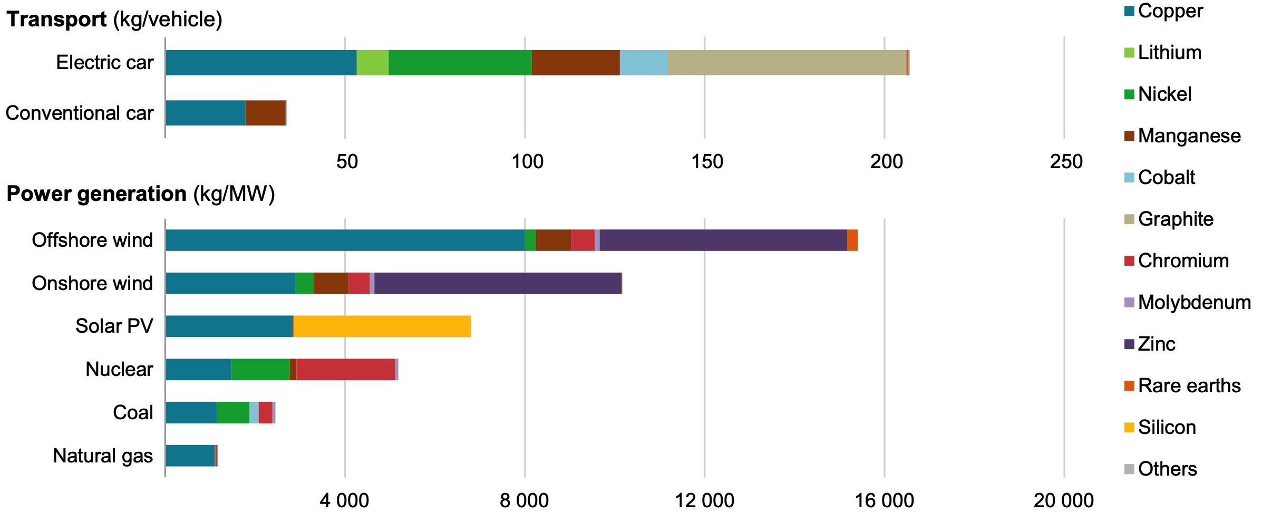
Alt-Energy Requires Staggering Amounts Of Metals, Minerals, & Magnets
Source: IEA, https://iea.blob.core.windows.net/assets/ffd2a83b-8c30-4e9d-980a-52b6d9a86fdc/TheRoleofCriticalMineralsinCleanEnergyTransitions.pdf 6.
© Robert Bryce

Slide 33
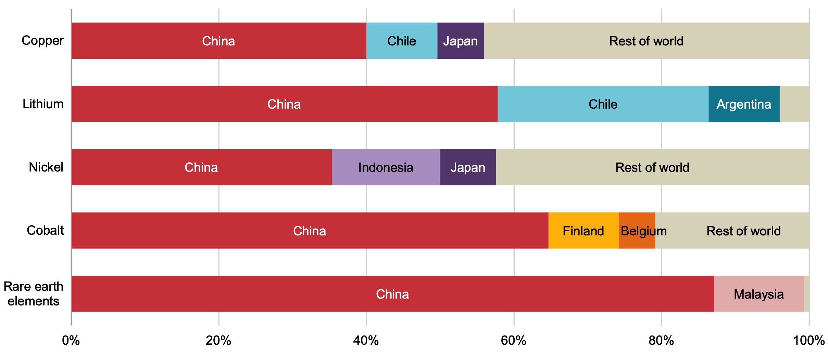
...And Near-Total Dependence On China
Shares Of Global Processing Market
Source: IEA, https://iea.blob.core.windows.net/assets/ffd2a83b-8c30-4e9d-980a-52b6d9a86fdc/TheRoleofCriticalMineralsinCleanEnergyTransitions.pdf, 31.
© Robert Bryce

Slide 34
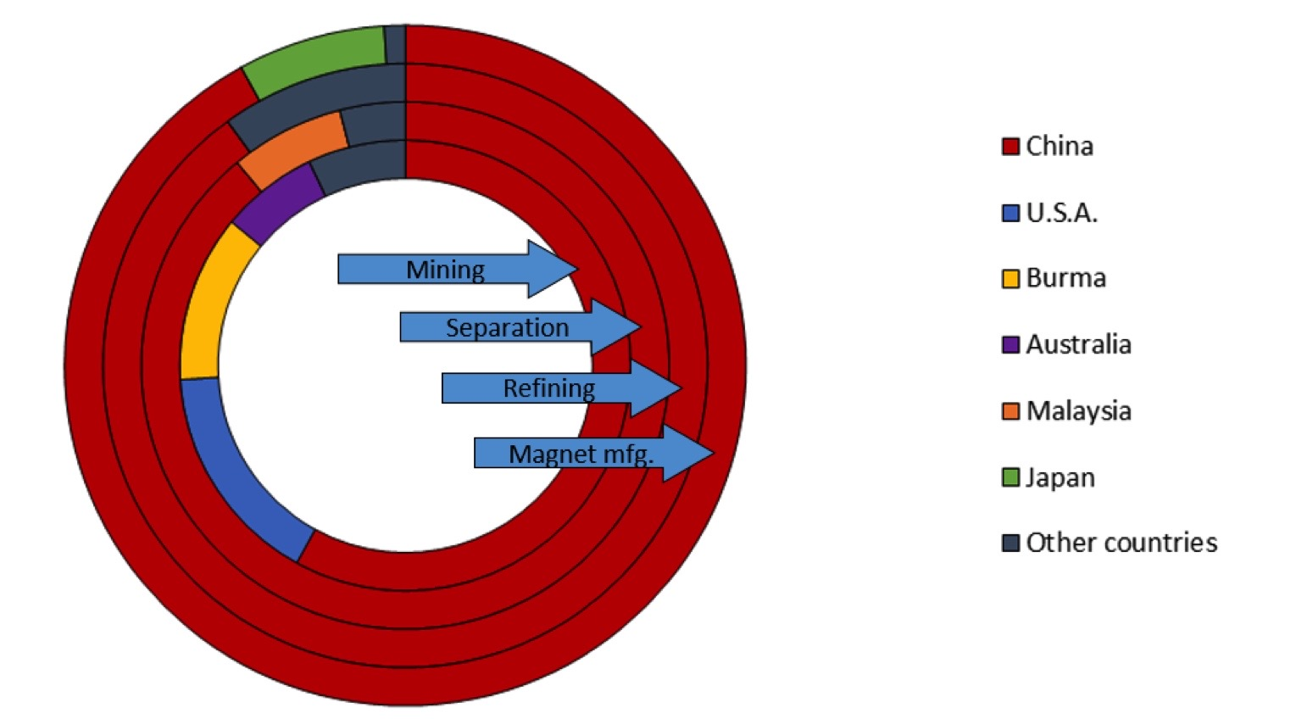
China Controls 90% of Global Market For NdFeB Magnets
Source: https://www.energy.gov/sites/default/files/2022-02/Neodymium%20Magnets%20Supply%20Chain%20Report%20-%20Final.pdf .
© Robert Bryce
Notes:
New DOE report: China controls 92% of Nd magnet production.

Slide 35
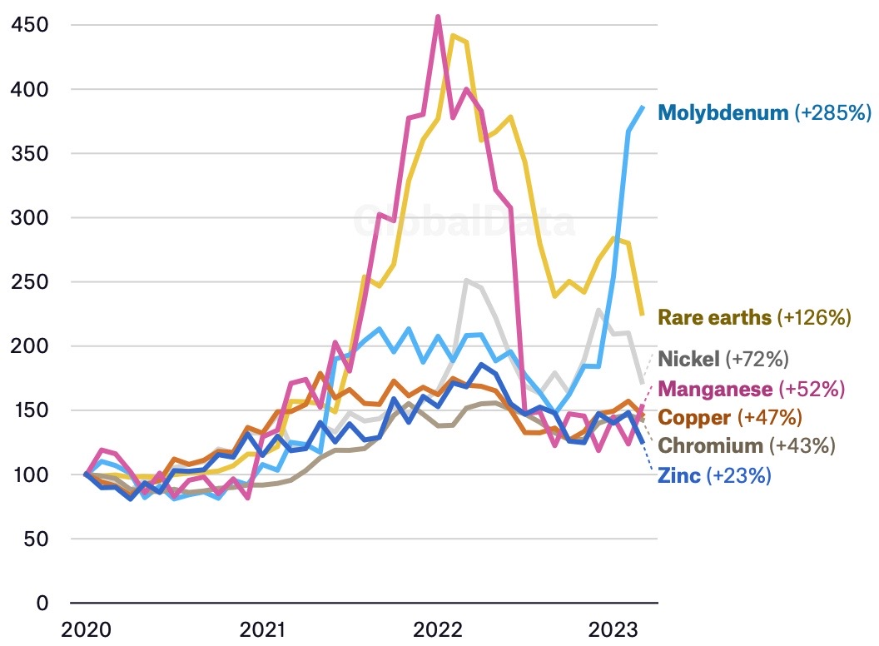
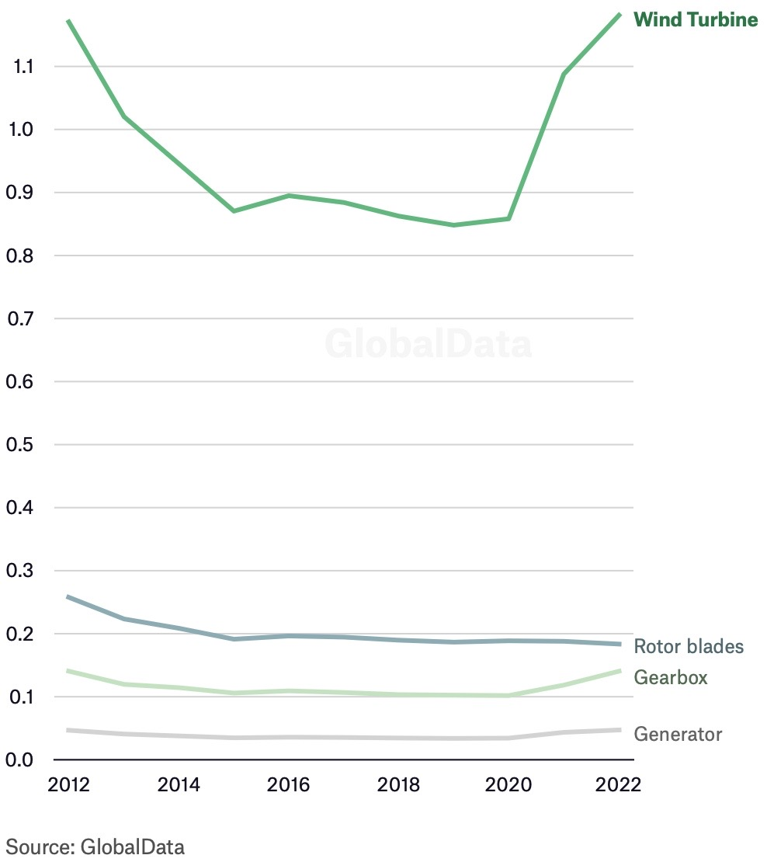
Since 2020, Price Of Metals Needed By Wind Turbines Up 93%, Turbine Prices Up 38%
Cost Per MW, $Million
Source: https://www.energymonitor.ai/tech/renewables/data-insight-the-cost-of-a-wind-turbine-has-increased-by-38-in-two-years/
© Robert Bryce

Slide 36
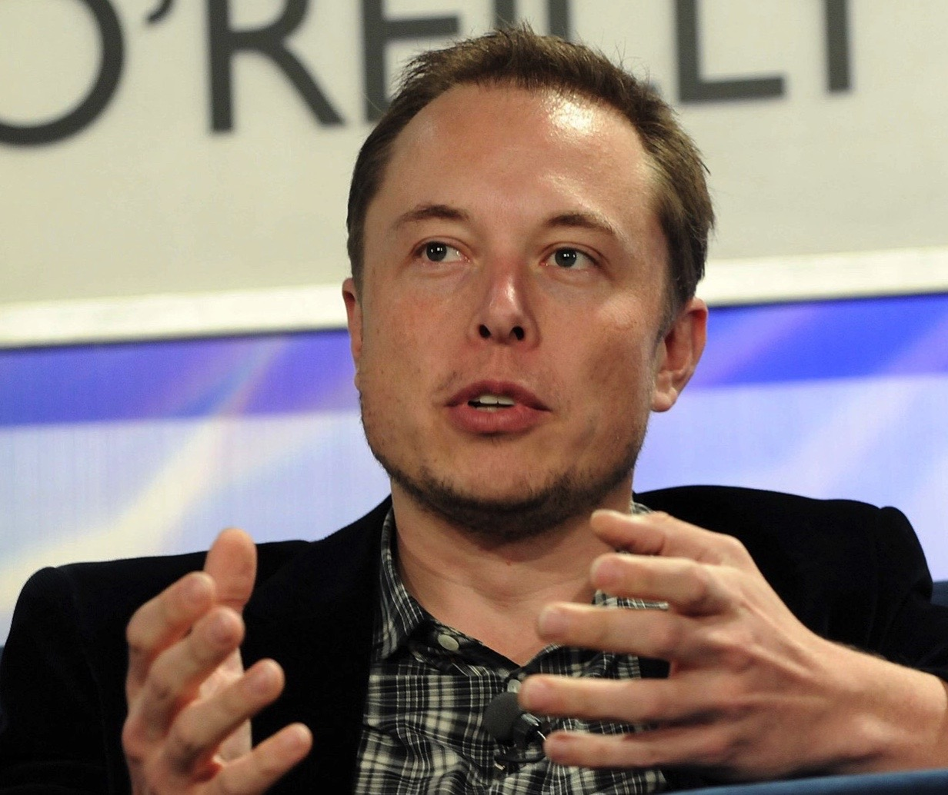
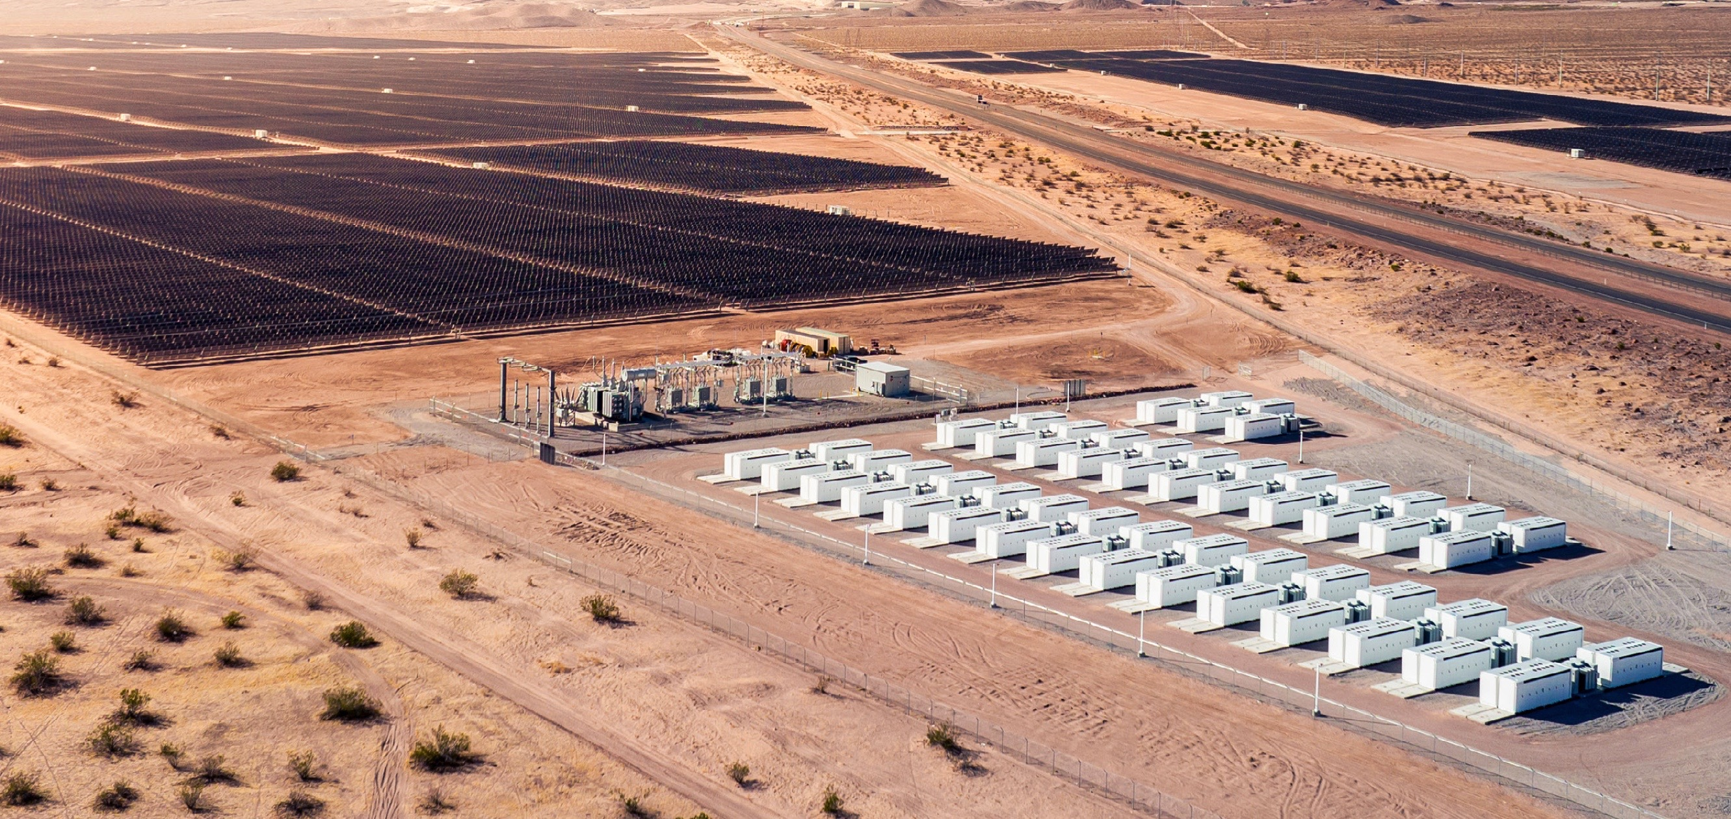
Tesla’s “Master Plan Part 3: Sustainable Energy for All of Earth,” April 5, 2023:
Sources: https://www.tesla.com/ns_videos/Tesla-Master-Plan-Part-3.pdf
© Robert Bryce
Notes:
Overreliance on imports, renewables, and nat gas.

Slide 37
Details, Details, Details...
© Robert Bryce
Sources: EIA, https://insideevs.com/news/531057/tesla-gigafactory-nevada-1000000th-battery/
Notes:
Overreliance on imports, renewables, and nat gas.

Slide 38
Elon’s Terrible, Horrible, No Good, Very Bad Battery Math
At TSLA’s current production rate, producing 240 TWh of storage will take 960 years!
Gigawatt-hours of battery storage
Source: Tesla, https://insideevs.com/news/531057/tesla-gigafactory-nevada-1000000th-battery/
© Robert Bryce

Slide 39
What About The Billions Of Waste Li-ion Batteries? Recycling Rates For Common Consumer Items
Sources: https://www.afandpa.org/news/2021/recycling-during-pandemic-2020-paper-and-cardboard-recycling-rates-are ;https://www.waste360.com/e-waste/report-recycling-rate-lead-batteries-us ; https://www.epa.gov/facts-and-figures-about-materials-waste-and-recycling/glass-material-specific-data,
BBC, https://www.bbc.com/news/business-56574779, Recycling Today, https://www.recyclingtoday.com/article/aluminum-cans-recycled-twice-plastic-bottles/
© Robert Bryce
Notes:
DOE report: China controls 92% of Nd magnet production.

Slide 40
Best No-Regrets Strategy Is N2N: Natural Gas to Nuclear
● 3B+ people need a LOT more juice
● Renewables can’t scale, not dispatchable, land-use
● N2N: Highest power density & EROEI
● N2N: Low resource intensity
● N2N: Technologies are mature & scalable
© Robert Bryce

Slide 41
Energy Realism
Is
Energy Humanism
©Robert Bryce
Notes:
We have to be clear about what is at stake here.
You have to push energy realism. Energy fantasies drove Europe into the ditch.
The US must avoid that fate.

Slide 42
Juice: How Electricity Explains the World

Slide 43
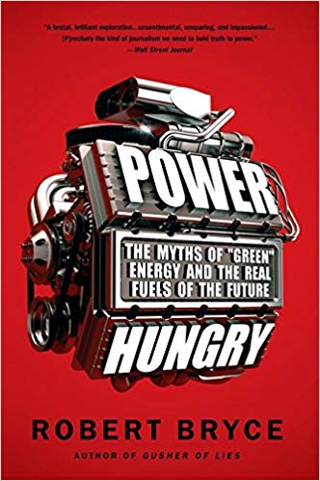

Slide 45
RobertBryce.Substack.com @pwrhungry Thank you
Notes:
END

