Slide 1
Energy Trends Workshop
Michael Fehr
SVP, Renewable Generation & Compliance

Slide 2
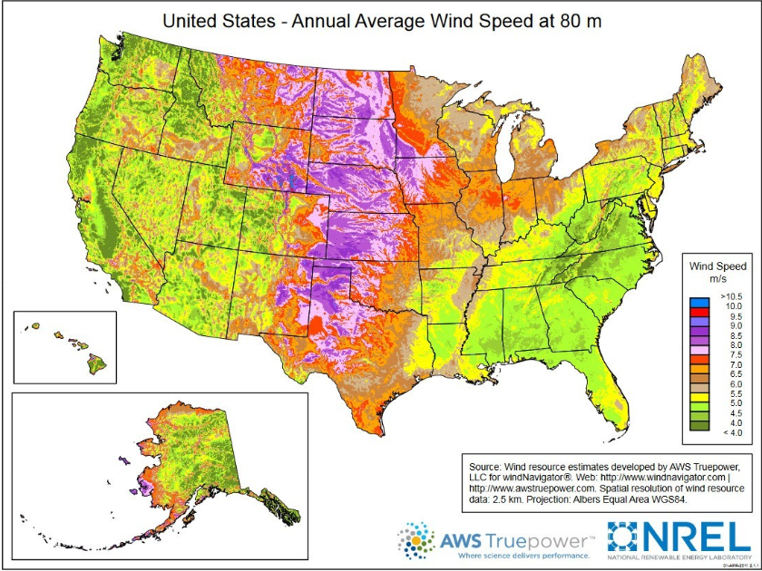
Wind Resource

Slide 3
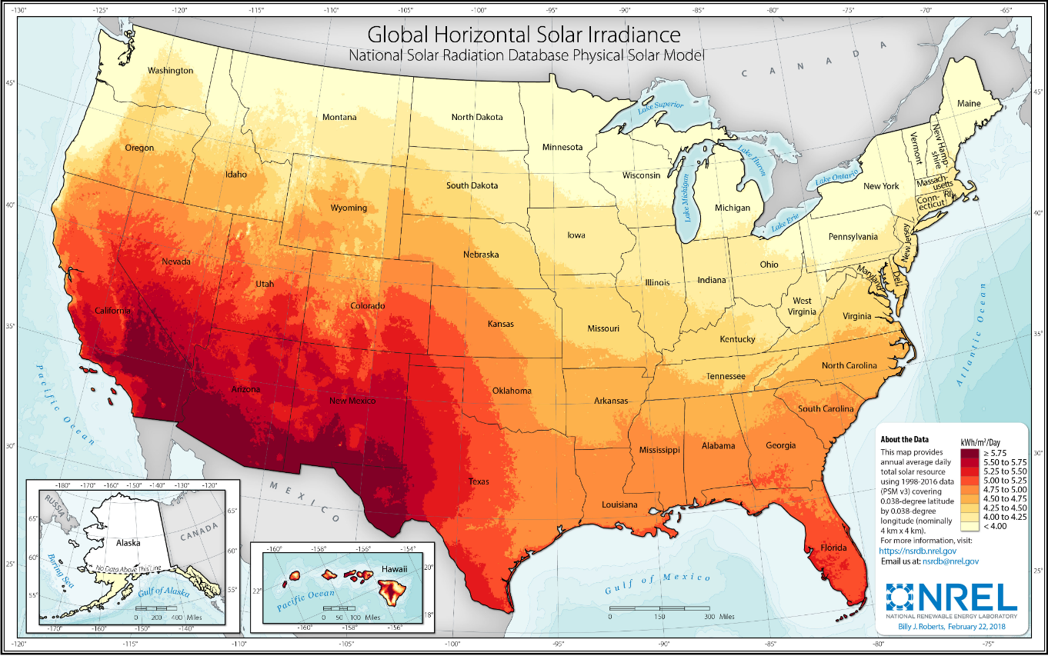
Solar Resource

Slide 4
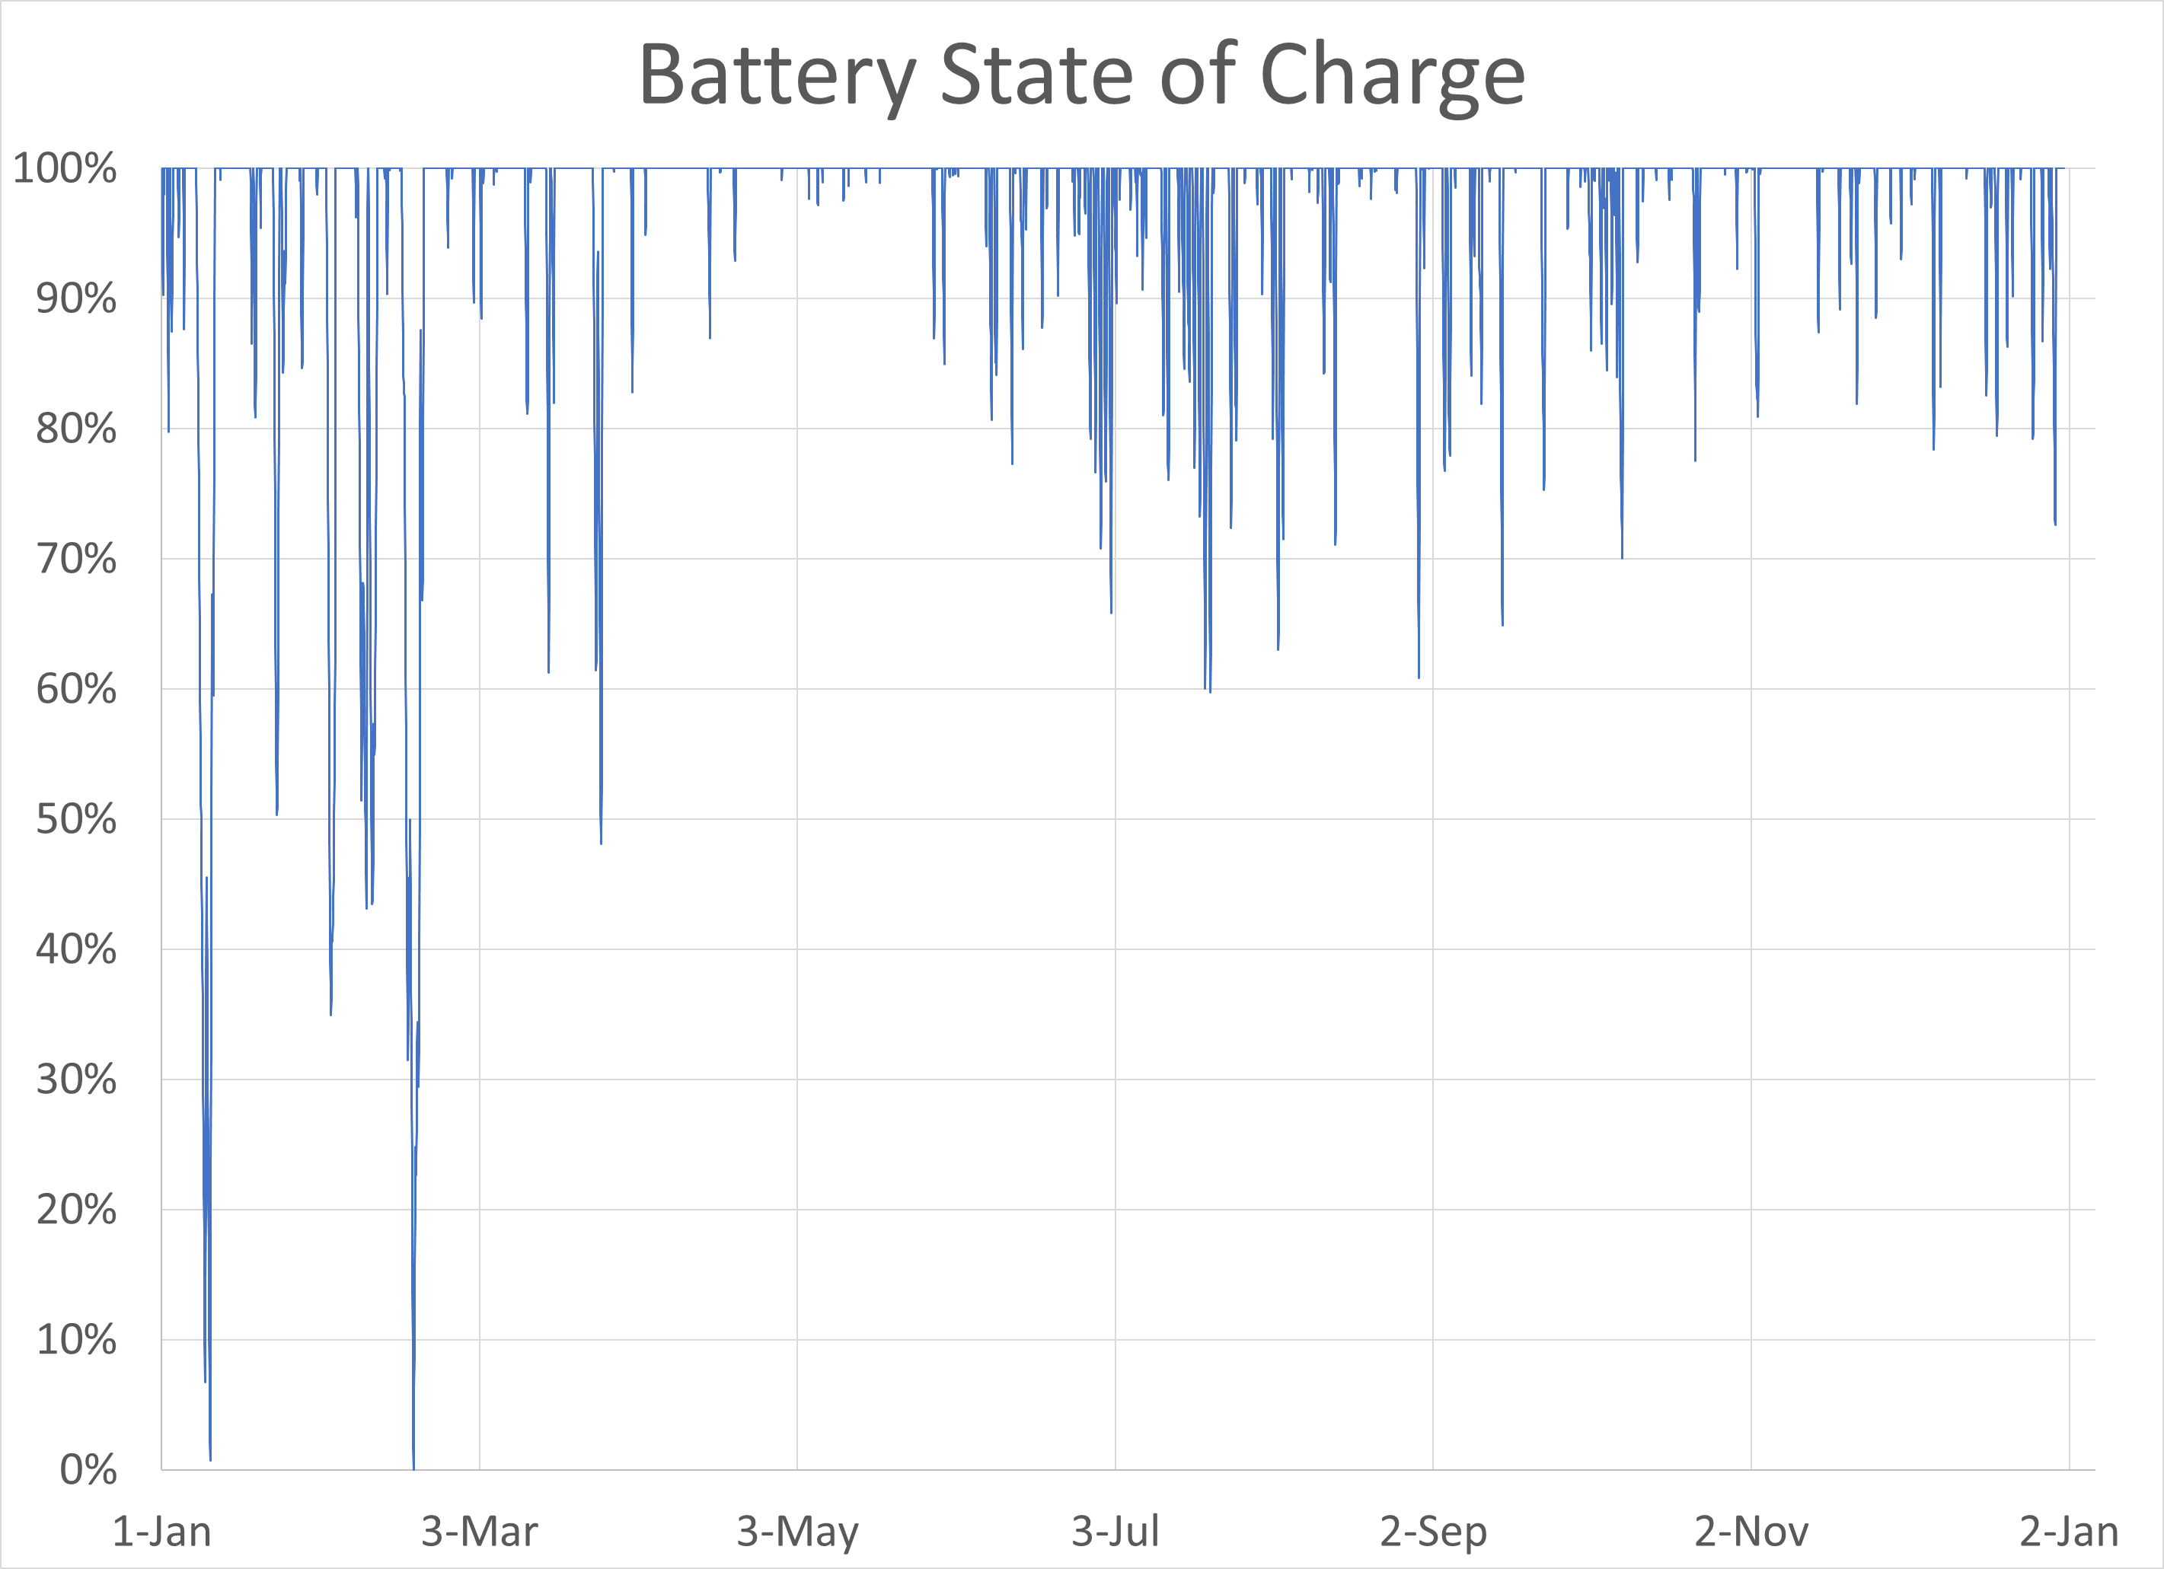
Battery
Notes:
From Iowa City calculation, existing MEC non-carbon emitting (wind, nuclear, solar) plus incremental 200 MW of wind and 500 MW of solar and 2,680 MWh battery. Residential bill increase of $127/month for renewable & batteries, was $28/month with nuclear and batteries. $1.8b of incremental investment (about $24k/citizen of Iowa City). City of DSM based on an earlier year’s production shapes came to just under $38k/citizen.

